Slide 1
Converting data to friendly formats
Tools for scraping data

Slide 2
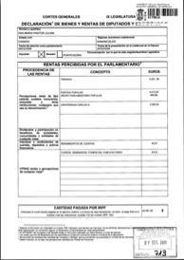
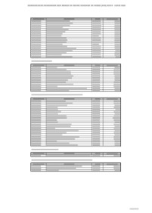
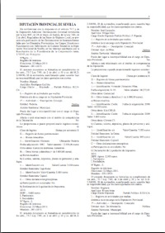
PDFs
Scanned Images
Computer-generated (searchable)
Tables
Complex formats

Slide 3
Tables
Copying and pasting into Excel does not usually work
Free online tools:
cometdocs.com
pdftoexcelonline.com
zamzar.com
pdftoexcel.org
Free desktop software
tabula.nerdpower.org

Slide 4
Let’s try it!
Open the File: China Economic Impacts of Pollution in the Country
Make sure you understand the data: read all codes, descriptions and legends
Convert file using one of the free online programs. We want to extract Table 2.
Review xls or csv file and evaluate whether the resulting tables are usable
Clean up table, eliminating unnecessary information, rows and note data source

Slide 5
Complex Formats
Columns, data divided among various lines, mixed with text
Automatic tools probably won’t work
The PDFs will have to be extracted and a programmer will use programming language to create a program to extract the data that you want

Slide 6
Scanned Images
Optical Character Recognition Software
For documents that you can’t search or select text
Quality depends on quality of image, clarity of text
Adobe Acrobat Professional: paid
Google Docs: free
Document Cloud: free. Advantage is that it allows you to annotate and publish your document as part of a multimedia publication. Your media outlet must request an account.

Slide 7
Scanned Images
Optical Character Recognition Software
For documents that you can’t search or select text
Quality depends on quality of image, clarity of text
Adobe Acrobat Professional: paid
Google Docs: free
New OCR http://www.newocr.com/ claims to work in Chinese

Slide 8
Let’s try it!
Open FSIS inspection letter
Open Google Drive
Select “Upload”
Choose “Convert text from PDF and image files to Google Documents”
Review quality
Make corrections by comparing original file to OCR output

Slide 9
Scraping data from the web
Browser scrapers:
Dafizilla Table2Clipboard for Mozilla Firefox
Scraper Extension for Chrome
Allow you to select tables on a website, including specific rows and columns
Copy the data tables and either create a Google spreadsheet or paste into a blank Excel file

Slide 10
Try it!
Google: “demographics of India”
Open wikipedia entry
Highlight table
Right click
In Chrome, select part of chart and “Scrape similar” and “Export to Google Docs”
In Firefox, select whole chart and “Table2Clipboard,” “Copy whole table” and paste in Google Doc or Excel

Slide 11
Google Docs Import HTML
Open http://en.wikipedia.org/wiki/China_at_the_Olympics
Open a Google Spreadsheet
Type in =importHTML("http://en.wikipedia.org/wiki/China_at_the_Olympics","table",7)
=function(“url”, “object” , number)

Slide 12
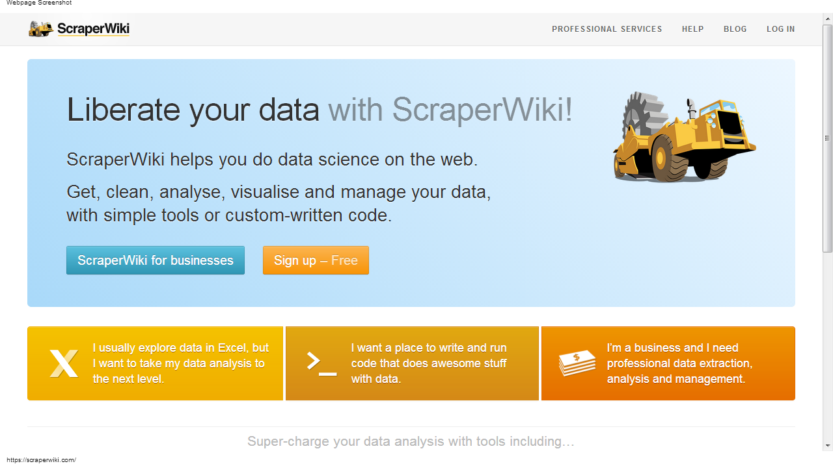
ScraperWiki: more complicated!

Slide 13
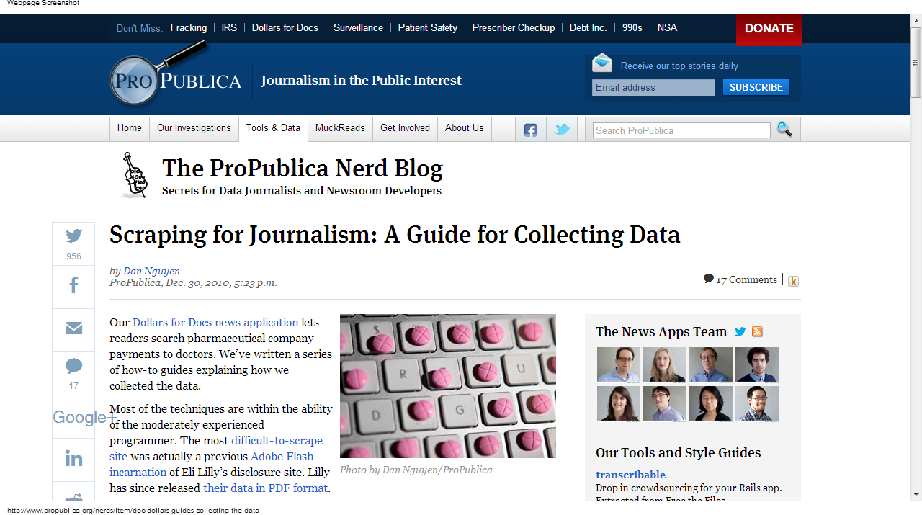
Scraping for Journalism: A Guide for Collecting Data by ProPublica

Slide 14
Need help scraping data?
Ask the School of Data.
Join the data driven journalism listserve.
Join Hacks/Hackers and go to the next meeting or post your question and ask for volunteers.
Check out http://open.dapper.net/ and http://import.io/ for online scraping tools.

